Slide 1

Feature Engineering using Signal Processing to predict DTC and DTS values
Bijit Krishna Goshwami Guide: Mr. Omprakash Dewangan
Enrolment no.: 202BTCS744060
Harsha Prasad Sah
Enrolment no.: 202BTCS312374
Satadal Deka
Enrolment no.:

Slide 2
Table of Content
S.N | Title | Slide no.
1. | Abstract | 3
2. | Introduction | 4
3. | Problem Understanding | 6
4. | Timeline Of The Project | 7
5. | Importing Libraries and the Datasets | 8
6. | Data Analysis And Preparation | 11
7. | Building ML Model | 12
8. | Evaluating ML Model | 13
9. | Performing Wavelet Transformation | 14
10. | Building and Evaluation of Model with Transformed Data | 15
11. | Reference | 16

Slide 3
1. ABSTRACT
In this project we aim to find out the effect of Wavelet Transformation using Signal Processing techniques on DTC and DTS velocities predictions.
DTC and DTS, these are the sonic log outputs, that the compressional and shear wave velocities.
The project is about using Wavelet Transformation which is one of the Signal Processing Technique.
We us it to predict sonic log which is one of the applications of Machine Learning in Petro Physics Industry.

Slide 4
Sonic log
2. INTRODUCTION TO OUR PROJECT
The sonic log is a porosity log that measures interval transit time of compressional sound wave travelling through one foot of formation.
It measures Compressional (DTC) and Shear (DTS) waves inside a formation. Formation is a chunk of piece of art.
Sonic log is widely used in the Geophysics industry and its Synthesis using Machine Learning Techniques will help the people in understanding the formation in a way effective way and in a more economical way.

Slide 5
Wavelets: A little wave
2. INTRODUCTION TO OUR PROJECT
Wavelet series: In mathematics, a wavelet series is a representation of a square-integrable function by a certain orthonormal series generated by a wavelet.
Wavelet transform can be viewed as the projection of a signal into a set of basis functions named wavelets. It is an application of Short Time Fourier Transform.
There are two types of Wavelets Transform:
Continuous Wavelet Transform
Discrete Wavelet Transform
This is used in many domains involving signals i.e., waves which can be either sound wave, electrical waves, Sonic Log waves, etc.

Slide 6
3. PROBLEM UNDERSTANDING
In this project we observed the effects of wavelet transformation on log data for sonic log prediction.
It was done in 3 steps:
Sonic log prediction using normal log data.
Performing Wavelet Transformation on log data.
Sonic log prediction using transformed data and observing the results.

Slide 7
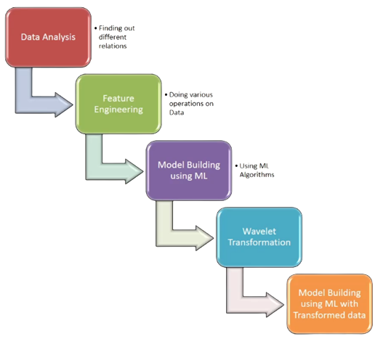
4. TIMELINE OF PROJECT

Slide 8
Following steps were carried out:
5. Importing libraries and the data sets
Imports
Data exploration and preparation
Model development
Model prediction and evaluation
Data was taken from Synthetic Sonic Log Curves Generation Contest

Slide 9
Description of the data
5. Importing libraries and the data sets
CAL – Caliper, unit in Inch,
CNC - Neutron, unit in dec
GR - Gamma Ray, unit in API
HRD - Deep Resistivity, unit in Ohm per meter,
HRM - Medium Resistivity, unit in Ohm per meter,
PE - Photo-electric Factor, unit in Barn,
ZDEN - Density, unit in Gram per cubic meter,
DTC - Compressional Travel-time, unit in nanosecond per foot,
DTS - Shear Travel-time, unit in nanosecond per foot,

Slide 10
Libraries imported:
5. Importing libraries and the data sets
Pandas
Numpy
Seaborm
Matplot
Sklearn
Xgboost (model used)
We used Jupiter notebook, used for machine learning using data science projects.
We import the data, we have train data to train our model and test data to test our model. The train data were around 30000 and the test data were around 11000.

Slide 11
Visualization of data:
6. Data Analysis and preparation
Plotted a histogram plot.
Plotted a line plot in a horizontal way.
Created a box plot to see the outliers.
Transferred the data into logarithmic scale.
Finding the correlation.

Slide 12
Model Development:
7. Building ML Model
We have to predict two parameters DTC and DTS so we will make separate datasets for them.
We used XB Boost model with tuned Hyperparameters for prediction of DTC and DTS separately.
Prediction for test data.

Slide 13
Evaluating ML model:
8. Evaluating ML Model
Importing the original prediction file.

Slide 14
Wavelet transforming:
9. Performing Wavelet Transformation
We selected a feature for which we will do the transformation.
We used SHAP value graph.
When we perform the wavelet transformation then it creates huge number of features.
We perform or we tend to perform the transformation only on one feature which has the highest importance.

Slide 15
10. Building and Evaluation of Model with transformed data
We will be predicting the results and look at the changes which we have done I our prediction.
Again, create separate datasets for DTC and DTS.
Every thing is the same, the only difference is the transformed data created.

Slide 16
11. Reference
[1] Zahoor Uddin, Ayaz Ahmad, Aamir Qamar and Muhammad Altaf. “Recent advances of the signal processing techniques in future smart grids”. Department of Electrical Engineering, COMSATS Institute of Information Technology, Wah Cantt 47040, Pakistan. https://www.researchgate.net/publication/322527495_Recent_advances_of_the_signal_processing_techniques_in_future_smart_grids
[2] Lokenath Debnath. “Wavelet Transforms and their applications”. Department of Mathematics, University of Central Florida, Orlando, FL 32816, U.S.A. https://www.researchgate.net/publication/238958371_Wavelet_Transforms_and_Their_Applications
[3] Vaibhav Kumar, M. L. Garg. “Predictive Analytics: A Review of Trends and Techniques”. Department of Computer Science & Engineering, DIT University, Dehradun, India https://www.researchgate.net/publication/326435728_Predictive_Analytics_A_Review_of_Trends_and_Techniques
[4] Mohammed H. Al-Aaraji, Hussein H. Karim. “Use of Attributes on 3D Seismic Data for Studying Mishrif Formation in East Abu-Amoud Field, South-Eastern Iraq”. Department of Geology, College of Science, University of Baghdad, Baghdad, Iraq. https://doi.org/10.24996/ijs.2021.62.12.18

